Slide 1
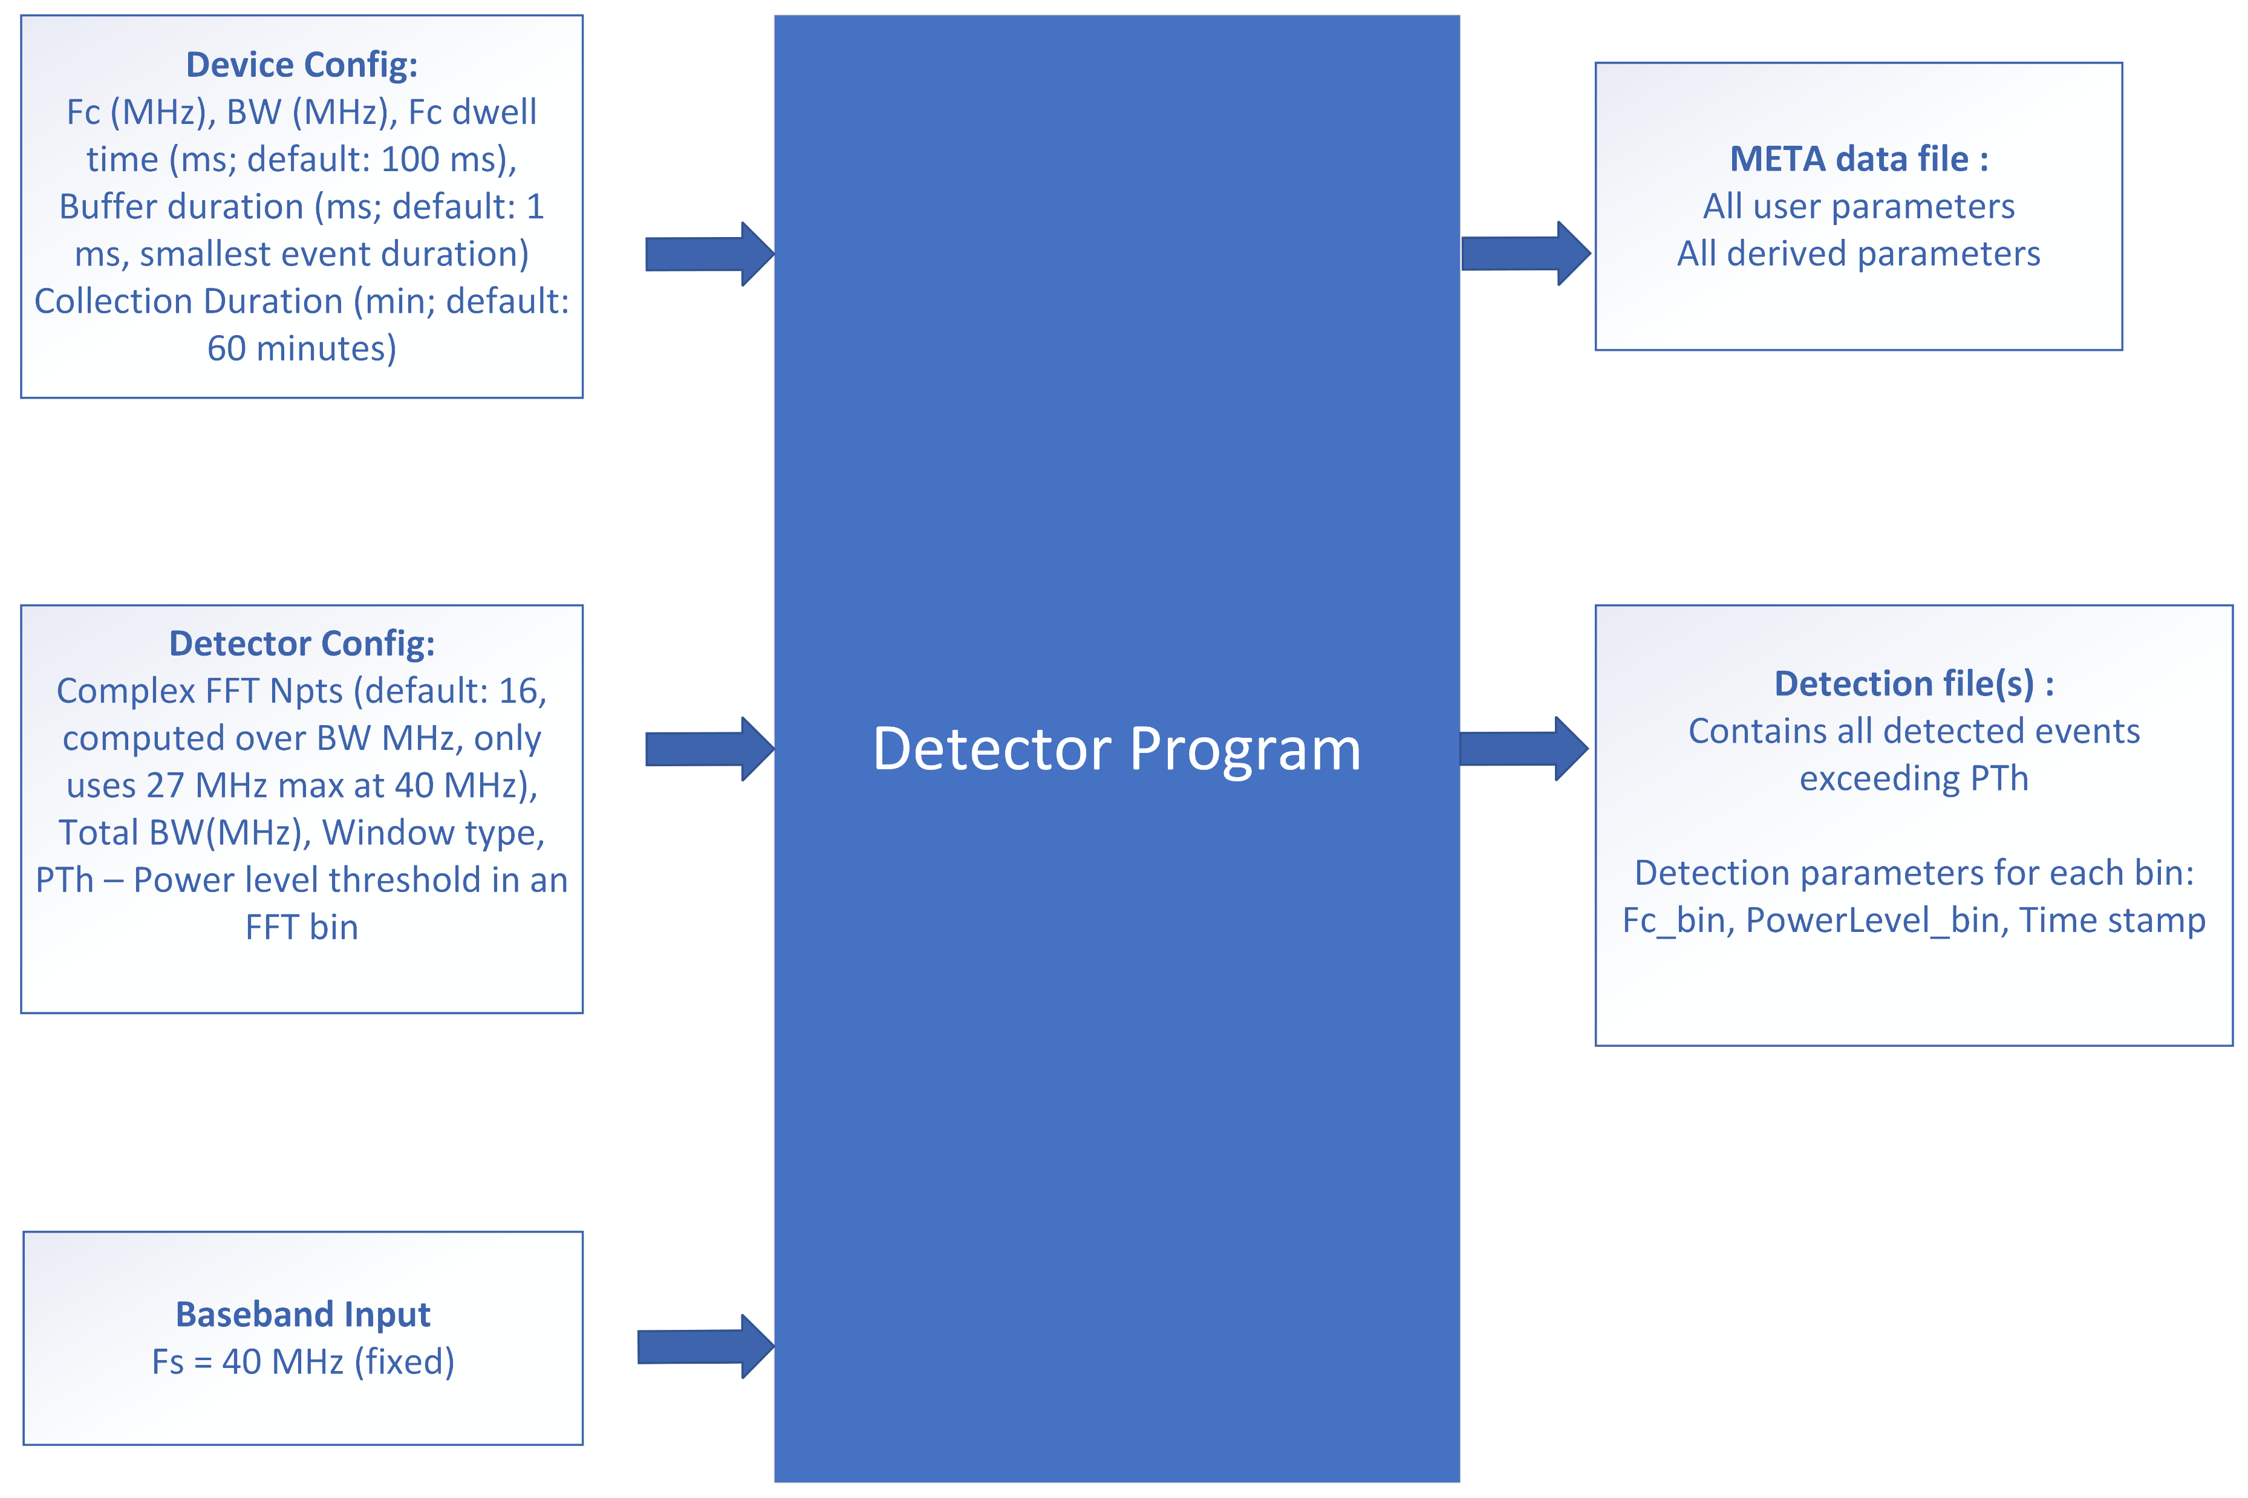
Requirements for the Spectrum Detector

Slide 2
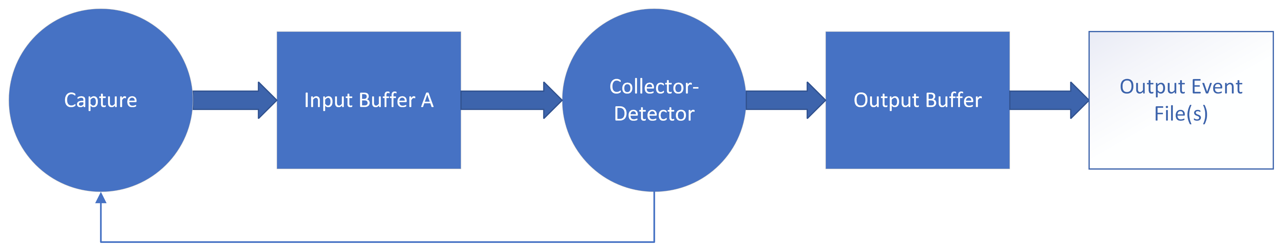
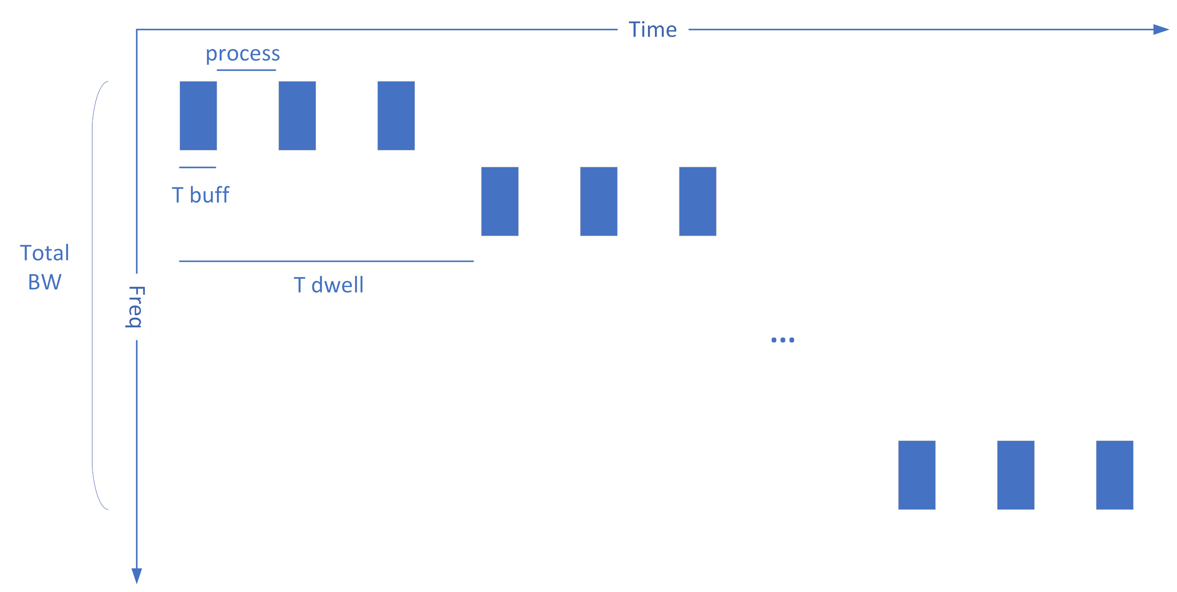
Sweep over Desire Bandwidth
Multi-threading with multi-input buffer could be used to decrease the process gap.

Slide 3
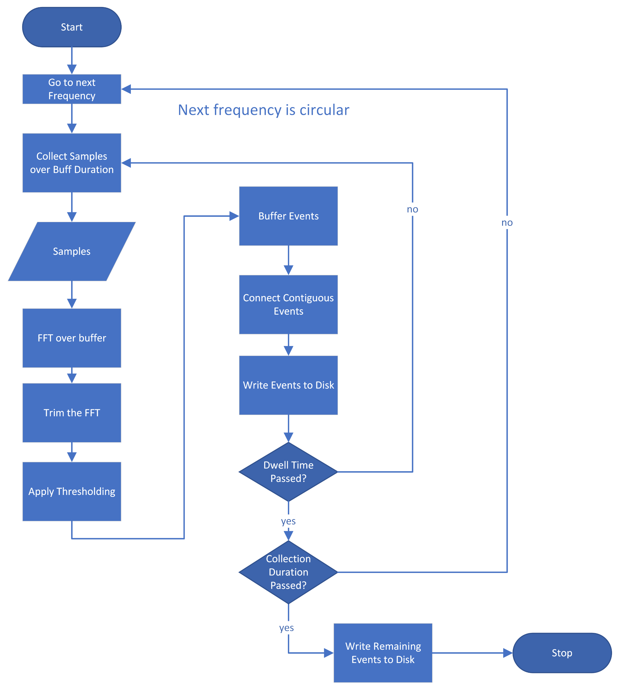
Process Flow

Slide 5
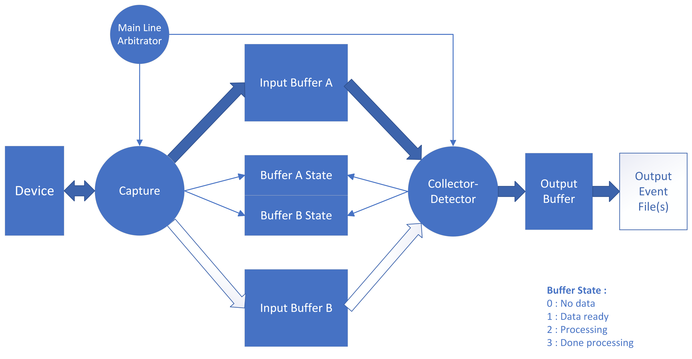

Slide 6
